Slide 1
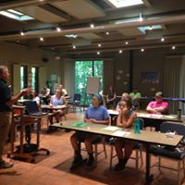
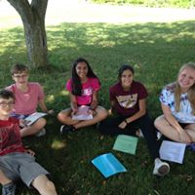
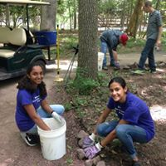
Conservation Leadership Program
JUNE 25-27, 2019
For Berks County students entering 9th -12th grades
Free 3 - day program 8:30am-3:30pm
Learn about careers in ecology & conservation from local leaders
Meet other Berks County students with an interest in the environment
Get to work on environmental improvement projects
GAIN COMMUNITY SERVICE HOURS FOR GRADUATION BY DOING SOMETHING UNIQUE & REWARDING THROUGH HANDS – ON ENVIRONMENTAL PROJECTS
Register by June 7, 2019!
To register, fill out the registration form and submit it to:
BCCD Suite 200
1238 County Welfare Rd.
Leesport, PA 19533
or email it to evan.corondi@berkscd.com
For questions:
610-372-4657

Slide 2
Conservation Leadership Program Registration Form June 25, 26, & 27 2019:
Program is FREE to Berks County Students entering 9th–12thGrade. Student is expected to attend all three days. First 20 registered applicants will be accepted. Please let us know if any accommodations are needed.
Register by June 7, 2019! To register: email this form to evan.corondi@berkscd.com
or mail it to BCCD Suite 200, 1238 County Welfare Rd. Leesport, PA 19533
______________________________________________________________________
Student: Last name First Name Middle Initial
_____________________________________________________________________
Home Address: City State Zip
____ Male ____Female
T-shirt size: (Adult) ____S ____M ____L ____XL ____XXL
___________________________________________________ School
________________ Grade entering 2019-2020 school year
_____________________________________________________________________
Parent/Guardian name Parent/guardian Signature (required if under 18 yrs. old)
_____________________________________________________________________
Parent/Guardian: Phone Parent/Guardian E-mail address
Program times are 8:30AM to 3:30PM each day June 25-27, 2019
Program will be held at two different locations by date
June 25 Location: Berks County Agricultural Center: 1238 County Welfare Road Leesport, PA 19533
June 26 Location: Antietam Lake Park, Bingaman House: 2843 Hill Road, Reading 19606
June 27 Location: Antietam Lake Park, Bingaman House: 2843 Hill Road, Reading 19606
By checking this box, I am allowing Conservation Leadership Program partners to utilize my child’s photo on their website, newsletter, social media, flyers etc.
Program Details:
The Berks County Conservation District and the Berks County Parks and Recreation Department are offering this program to Berks County high school students. This program is offered to all high school students in public, private, online and/or home schools. Students registering for the event are expected to attend all three days. All students and/or parents-guardians are responsible for their own transportation to the program locations. Also, students are responsible for supplying their own lunches/dietary needs for each day. Please dress for the weather and to work outdoors. The Conservation Leadership Program is modeled after a local conservationist named Don Hartman and strives to continue his conservation legacy.

